Slide 1
Exhibit Etiquette
How to have fun at the Exhibit
Our Stories: The History of Marathon County Exhibit
Marathon County Historical Society

Slide 2
Welcome to the Museum
We are so glad you came to visit us!
Here are a few
guidelines to help
you have
an enjoyable
experience

Slide 3
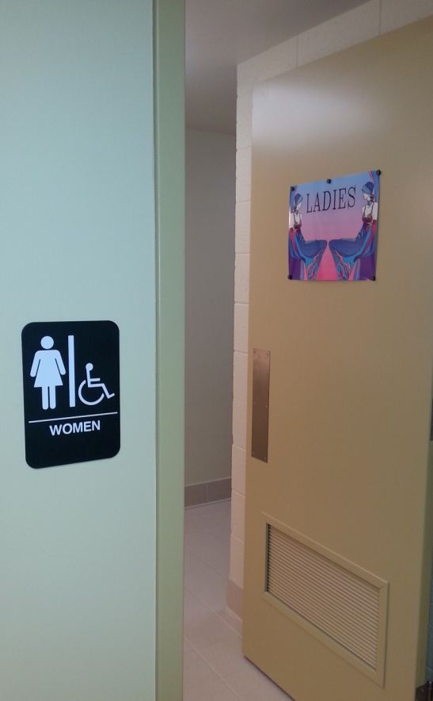
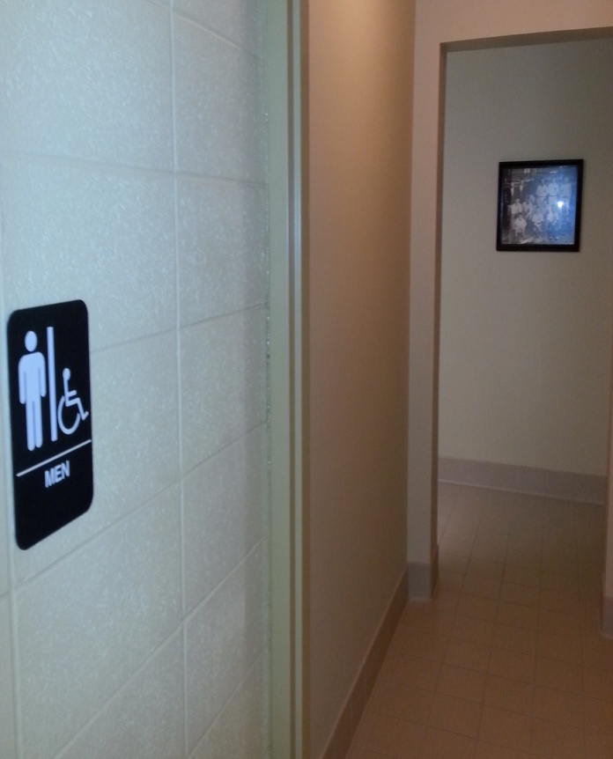
Use the restroom before entering the exhibit
You do not want to miss the tour!

Slide 4
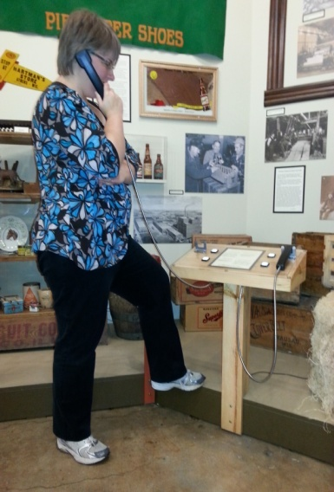
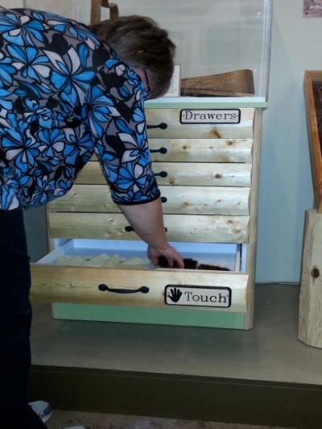
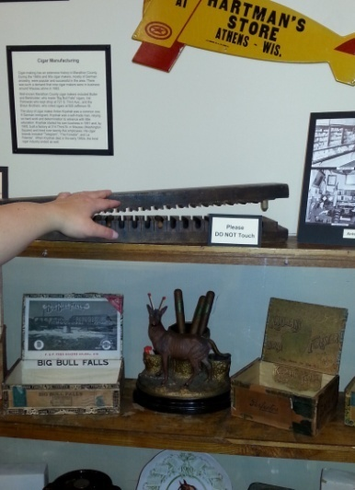
Keep hands and feet to yourself
If you need to, put your hands in your pockets, behind your back, or crossed in front
This will help others to pay attention
It will help you not to touch the exhibit
Of course you can gently touch anything with the hand symbol

Slide 5
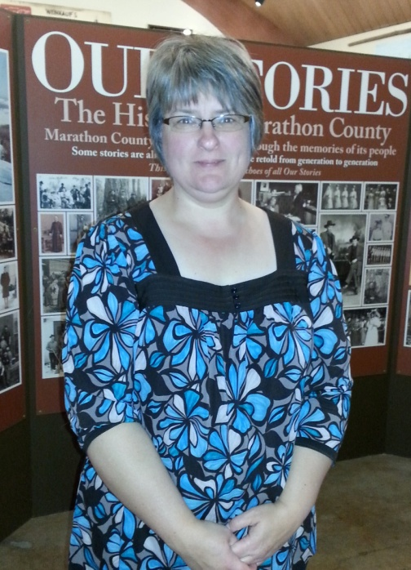
Pay attention to the leader
The leader will be telling stories, asking questions, and pointing out neat things in the exhibit
They will also answer YOUR questions

Slide 6
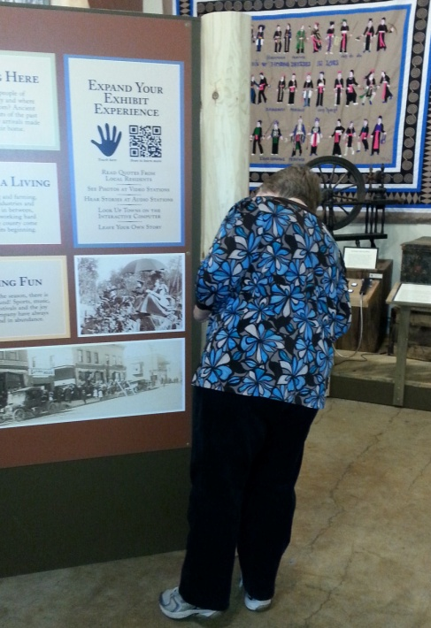
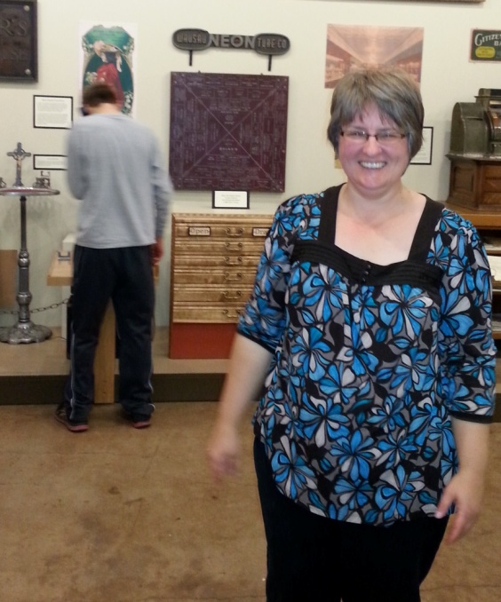
Stay with the leader
Always follow BEHIND the leader, not in front
Stay with the group, don’t stay behind when the group moves on

Slide 7
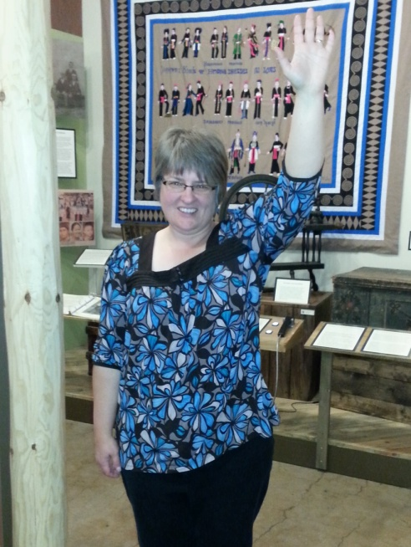
Ask questions
Ask the leader questions by raising your hand and waiting for them to call on you
Ask questions pertaining to the exhibit only
Keep other questions for after the tour ends
You may even want to write questions before you come

Slide 8
Review
Use the restroom before entering the exhibit
Keep hands to yourself
Pay attention to the leader
Stay with the leader
Ask questions
If you have Excellent Exhibit Etiquette we will have a great time!

